Slide 1


Slide 2
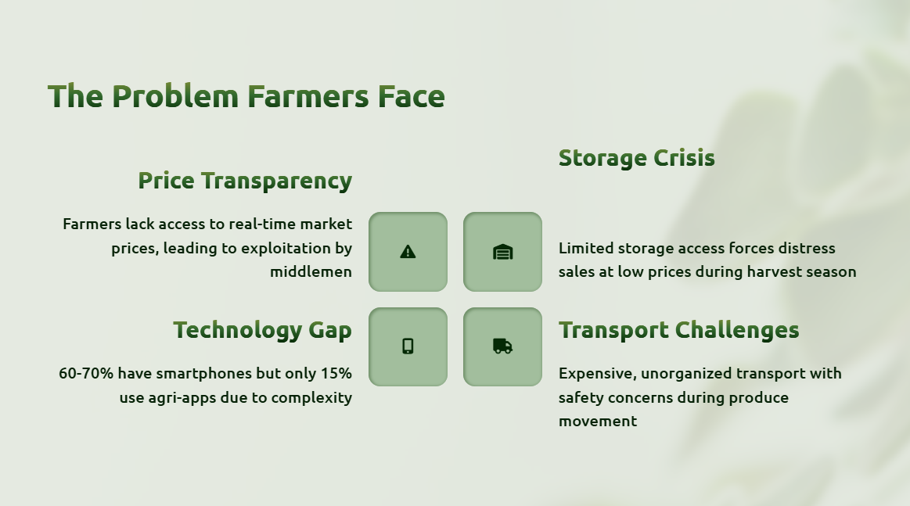

Slide 3
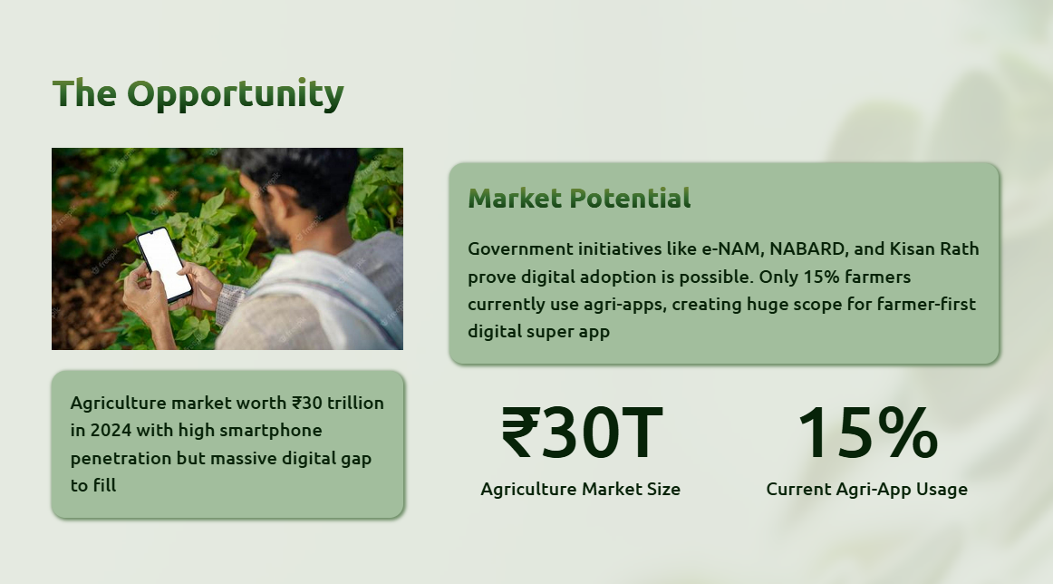

Slide 4
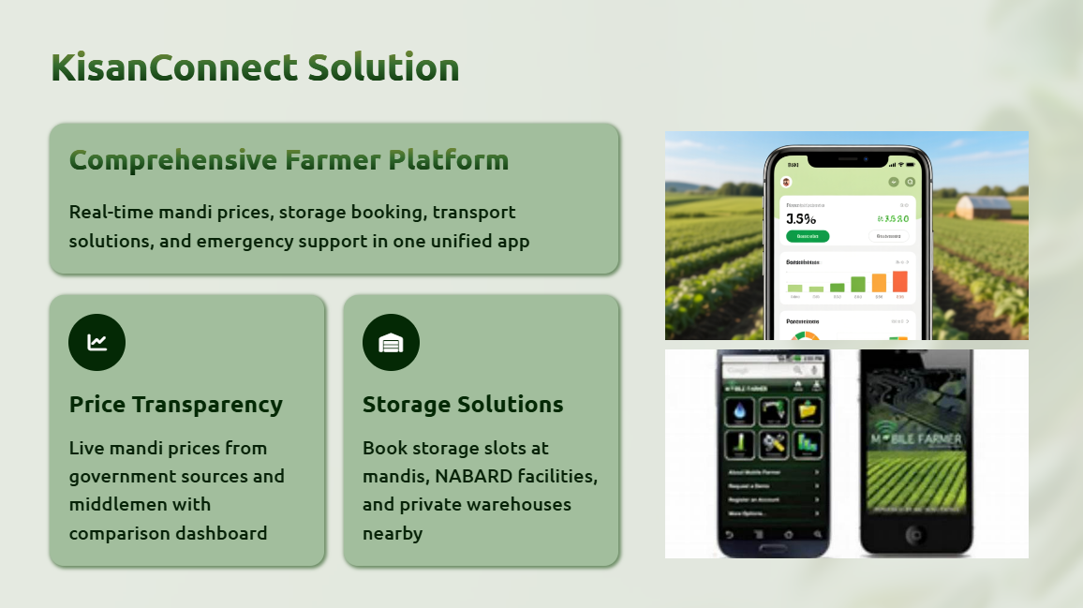

Slide 5
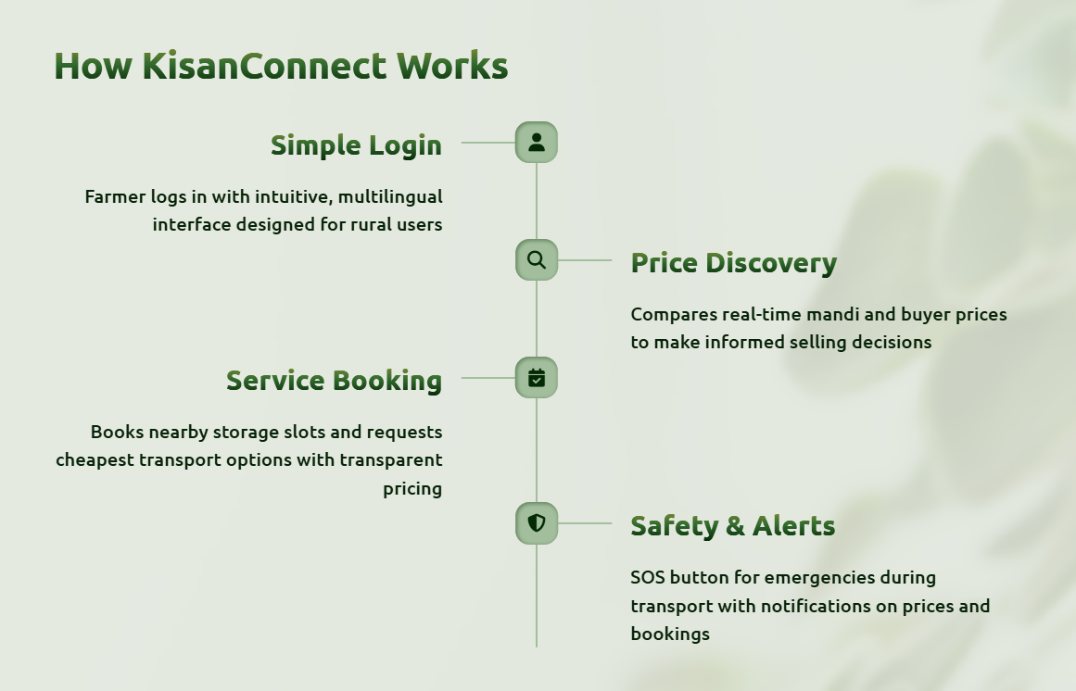

Slide 6
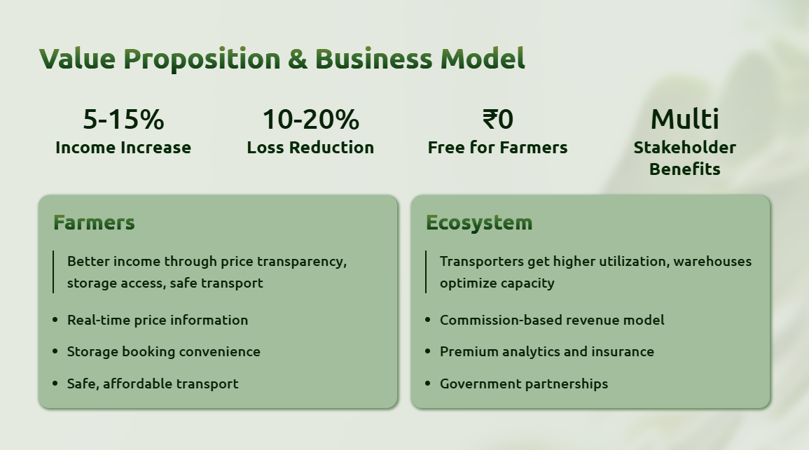

Slide 7
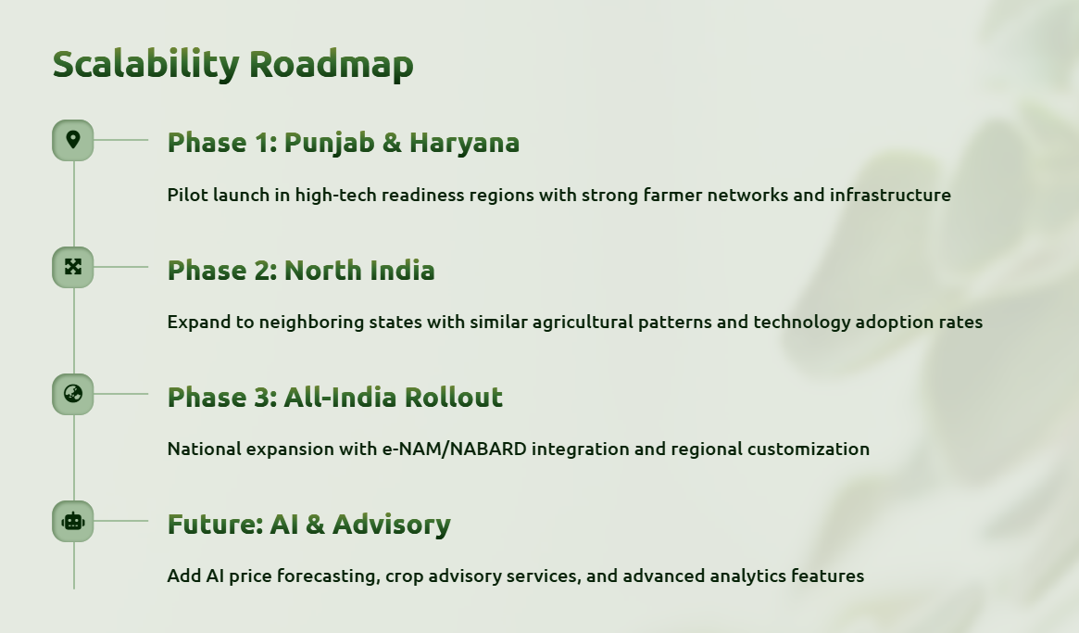

Slide 8

Future Goals
Seed Verification System: Farmers can enter the barcode number from seed packets directly on our app.
Authenticity Check: Instantly validates whether the seed is original or counterfeit.
Reduced Crop Failure: Protects farmers from losses caused by duplicate or false seeds.
This app will be directly connected to the local government inspector /mandi inspector platform to build trust on the authenticity

Slide 9

Notes:
v

